Slide 1
Boa Tarde!!!
Vamos iniciar às 15:30. Até este horário, sinta-se confortável.
Antes de iniciar, garanta que você consegue acessar o sítio: https://notebooks.azure.com.
Todas as nossas tarefas serão realizadas neste sítio.
Caso você não tenha uma conta da Microsoft, crie uma em: account.microsoft.com.
Notes:
Welcome to your <location> Microsoft Reactors. We are worldwide local community spaces where developers and startup leaders meet, learn, and connect. Reactors build a diverse community by providing training, learning paths, industry speakers, and seminars, plus meetups and other community events related to emerging technology trends.
Reactor learning, networking, and leadership opportunities are designed to focus on real-world challenges to enable members of the tech community to stay up to date and drive solutions. Reactors are a place to share knowledge and expand impact in the company of technology enthusiasts locally and globally.
We have workshops and other learning opportunities planned throughout the year. Or if you want to host your own event at a Reactor, you can make the request on our website.

Slide 2
Regressão e Outros Modelos Simples
29 de Julho de 2020
Microsoft Reactor | São Paulo

Slide 3
Flavio Figueiredo
Professor
Universidade Federal de Minas Gerais
@flaviovdf

Slide 4

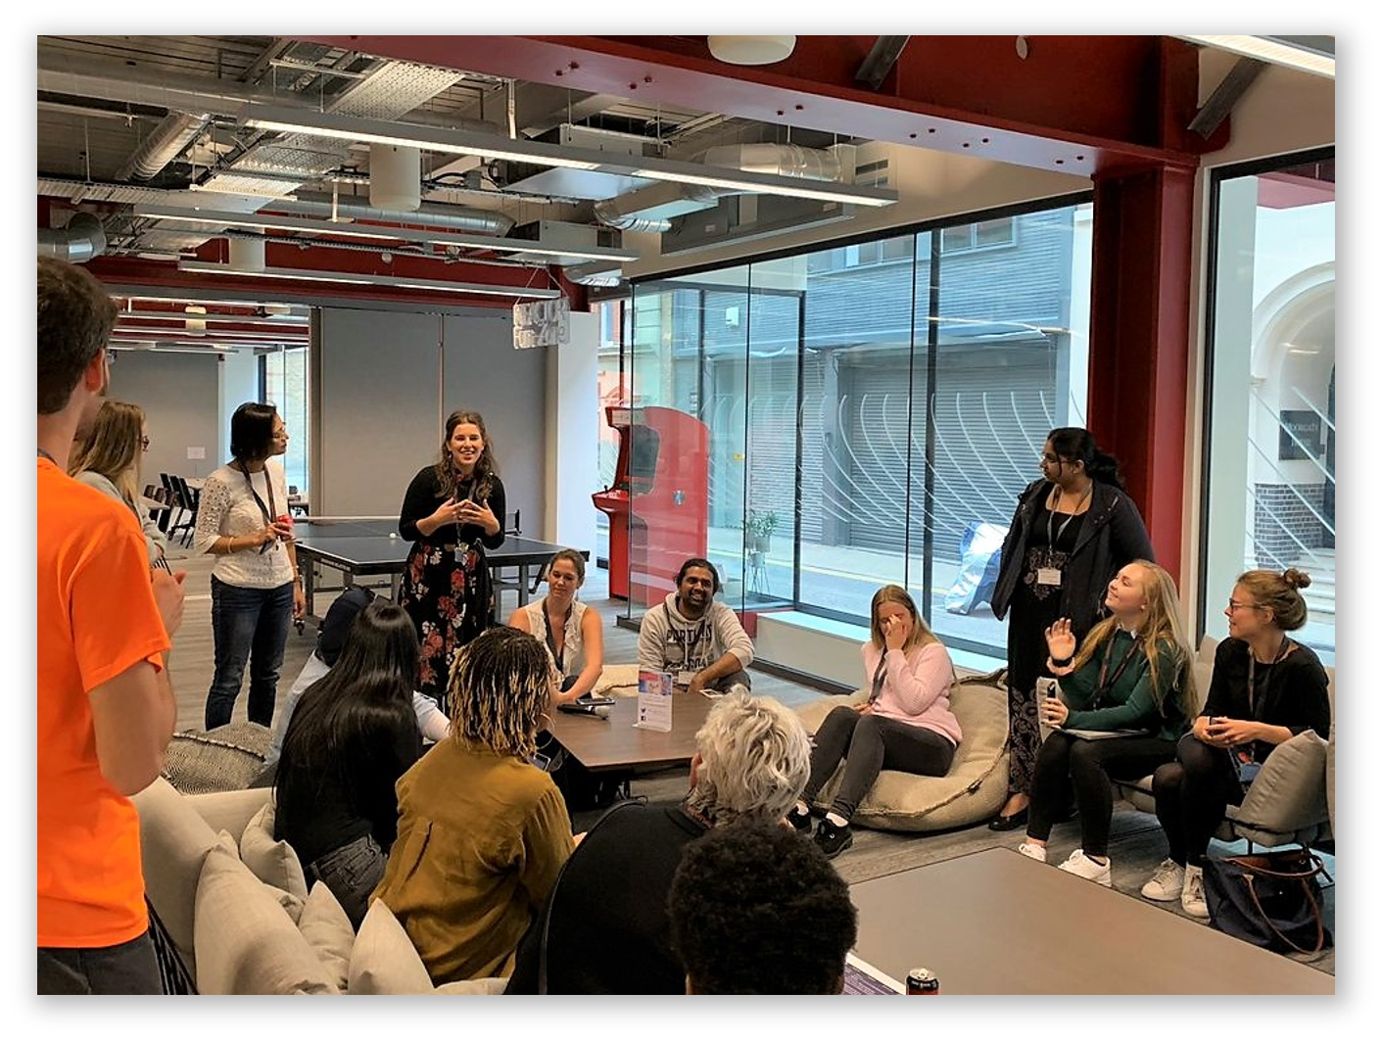
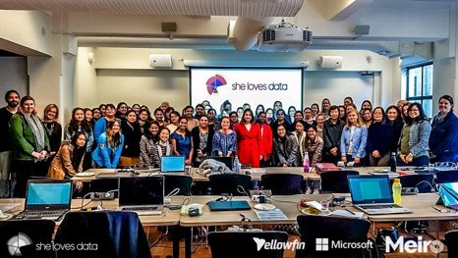

developer.microsoft.com/reactor/
@MSFTReactor no Twitter
Notes:
Welcome to your <location> Microsoft Reactors. We are worldwide local community spaces where developers and startup leaders meet, learn, and connect. Reactors build a diverse community by providing training, learning paths, industry speakers, and seminars, plus meetups and other community events related to emerging technology trends.
Reactor learning, networking, and leadership opportunities are designed to focus on real-world challenges to enable members of the tech community to stay up to date and drive solutions. Reactors are a place to share knowledge and expand impact in the company of technology enthusiasts locally and globally.
We have workshops and other learning opportunities planned throughout the year. Or if you want to host your own event at a Reactor, you can make the request on our website.

Slide 5
Nossa Agenda de Hoje
Introdução
Regressão Linear (2)
k-means
Fim do Curso
Naïve Bayes
Intervalo
Regressão Linear (1)

Slide 6

Notes:
Data defines the world around us. The combination of mountains of data and computing that is both powerful enough and economical enough to make sense of that data has led to huge breakthroughs in science, medicine, and the consumer technologies that we now take for granted. But for all the advances that the data revolution has made, it is still held back by a resource shortage: people; specifically, people with technical skills in data science who can navigate this growing field and help explain discoveries in it to others.
For example, we might be able to:
- Assist doctors with detecting tumors on an MRI scan that might otherwise be too small to be noticed at first
- Help farmers increase their crop yields and use fewer resources like water and fertilizer
- Help a person who is blind identify people or obstacles in front of them
- Reduce defects in the manufacturing process
The video we watched shows the power and affordability of big data processing on cloud platforms like Azure. DNA sequencing analysis is a form of life-sciences research that has the potential to lead to a wide range of medical and pharmaceutical breakthroughs. However, this type of analysis requires supercomputing resources and big data storage, which many researchers have lacked before now. Working through a grant provided by the National Science Foundation in partnership with Microsoft, a team of computer scientists at Virginia Tech addressed this challenge by developing an on-demand, cloud-computing model using data & analytics services. By moving to an on-demand cloud computing model, researchers now have easier, more cost-effective access to DNA sequencing tools and resources, which could lead to even faster, more exciting advancements in medical research.
This workshop is about bridging the shortage of practitioners with technical skills in data, particularly in data science. Everyone should care about data science; you are here today because you are choosing to act to gain more information and skills in this vital, rapidly growing field. This course will give you a broad overview of many of the fundamental skills in data science using two of the most ubiquitous tools of the data trade: the Python programming language and the Jupyter Notebook interface. This course will give you a basic grounding in data science and some practical tools for performing it; these outcomes will provide you with the foundation from which to acquire deeper skills in this field, such as through the Microsoft certification for data science.

Slide 7
O que é Ciência de Dados?
Conhecimento do Domínio
Ciência de Dados
Estatística
Programação
Notes:
Data science is gaining momentum because of 3 advancements in computing:
Ubiquity of data: Our devices and sensors are capable of creating terabytes worth of data every day.
Access to nearly limitless compute power, available to anyone with an internet connection.
Powerful algorithms that help us unlock more insight than ever from the data we have.
(feel free to elaborate on the above with examples, hold up your phone or Apple Watch for examples of consumer solutions)
Data science itself is not a new field. Statisticians like to say that data science is statistics rebranded. Some say its statistics at scale for big data.
We would suggest that (modern) data science sits at the intersection of 3 primary skills:
It has a foundation in statistics with well-established math community and generally-accepted techniques like statistical significance and linear regression.
Sophisticated data science requires people with coding experience to prepare data and build models that scale with accuracy.
But often overlooked (and arguably most importantly), data requires domain expertise--to begin with research questions, to sport inaccuracies in the data set, to know what you’re looking for, to interpret the results, and to communicate them.
Anyone can contribute to data science–whether you’re a statistician, software engineer, business leader, or the foremost authority on butterfly migration patterns (natural scientist).

Slide 8
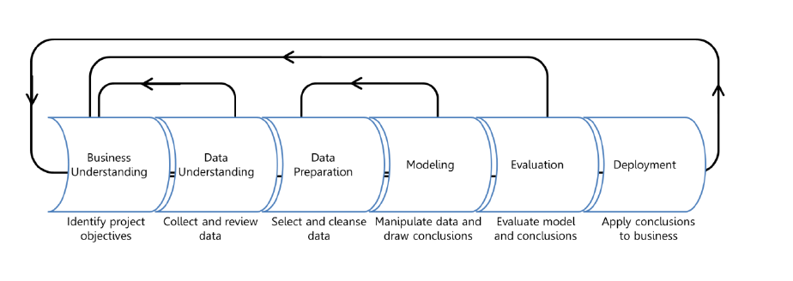
Ciência de Dados: O Processo
O principal objetivo é na extração de valor de grandes quantidades de dados. Tal extração é interpretada por humanos!
Domain Expertise
Data
Science
Code/Computing Expertise
Math/Statistics
De Introduction to Data Science: https://docs.microsoft.com/learn/modules/intro-to-data-science-in-azure/2-data-science-process
Material de apoio: https://docs.microsoft.com/en-us/azure/machine-learning/studio/data-science-for-beginners-the-5-questions-data-science-answers
Notes:
So before we start experimenting with code and data science techniques, it’s important to begin with a conceptual understanding of how data science often works. We begin by…
1. Understanding the Business Problem
In any problem-solving method, the problem must first be identified. This can either be in the form of a question or a statement. In each situation, there is always a general business understanding that will motivate the data science process.
In our example, your company understands they could be selling more brooms if they knew how many they could expect to sell each month and then stock their shelves accordingly.
2. Understanding and Preparing the Data
Data understanding comes from the process of acquiring and exploring available data. This step involves obtaining and preparing the data to be used in model training. To train models, it's important to understand the data. Data scientists start by performing exploratory data analysis (EDA) to better understand the data with which they are working, and identifying which data elements drive the outcome they want to predict. With this understanding, we can cleanse the data and extract the features required for modeling.
Your company gives their data to the data science team. The data engineer cleans and preps the data so that it's ready for the modeling process. EDA helps you learn about the relationship among data elements, which helps determine which data (or features) you will need to train the model. For example, it might help to know what people most frequently buy with brooms.
3. Modeling the Data
The modeling step is a cycle of steps that occur to improve results. Modeling can consist of several techniques, but typically one cycle iteration is not enough to produce good results, so the cycle is repeated until the desired results are achieved.
You use the available data and move into modeling and feature engineering. For this type of question where there are many different numerical variables, you try a time series model and evaluate its performance.
4. Deploying
This step is usually left to the developers. It consists of integrating the solution into the business to solve the original problem. For your company, deployment would mean using the prediction of broom sales to properly stock the shelves.
Summary
Data science is a data-driven process that starts with a question. Data acquisition and understanding then drives the modeling. The steps a data scientist usually focuses on are data understanding and modeling, which is where the results are produced. After that, the developer implements the results to test the performance.

Slide 9

Modelo
Entrada Sensorial
Ação
REDE NEURAL
Notes:
//Instructor, modify example as it pertains to your personal circumstances.
I’m a parent. Who else here is a parent? Mine are teenagers now, and it’s trite to say it, but it seems like they were just babies yesterday. And it seems like just yesterday that I was a lot younger too, a hopelessly naïve new parent who thought that the job of a parent is to teach his children things. To explain the world to them. And actually, I remember being stressed out because I didn’t know everything. How was I going to explain the world to my baby if I didn’t know everything? I literally started reading a lot more nonfiction.

Slide 10

Modelo
Dados
Resposta
Notes:
The first time I showed this to someone I asked how they liked my drawing and they said, “it scared me.”

Slide 11
Algoritmo
Morte?
Notes:
Start with a specific question: “Is this retinal scan of a diseased eye?”
Build the puzzle by necessity. Don’t mention something new (features) until you need it.
Built the puzzle.
Talk about how you spend your time (calling out data wrangling as something that developers already do—“metadata scientist”).
Talk about math, how much you need, where you need it.
Also a chance to talk about hidden bias in data, e.g. how it skews towards men in software. So an ML “should I hire this person” would weight men heavily. The data is not bad, it’s just reflecting a situation that is itself the result of bias. The way to subtract it is to extract it explicitly.
But this is also an opportunity! We can’t subtract bias from people’s brains, but we can subtract it from models. So that “hiring engine” may in the end be a force for social justice.

Slide 12
NÃO PRECISA SER BOM EM MATEMÁTICA
… MAS AJUDA.

Slide 13
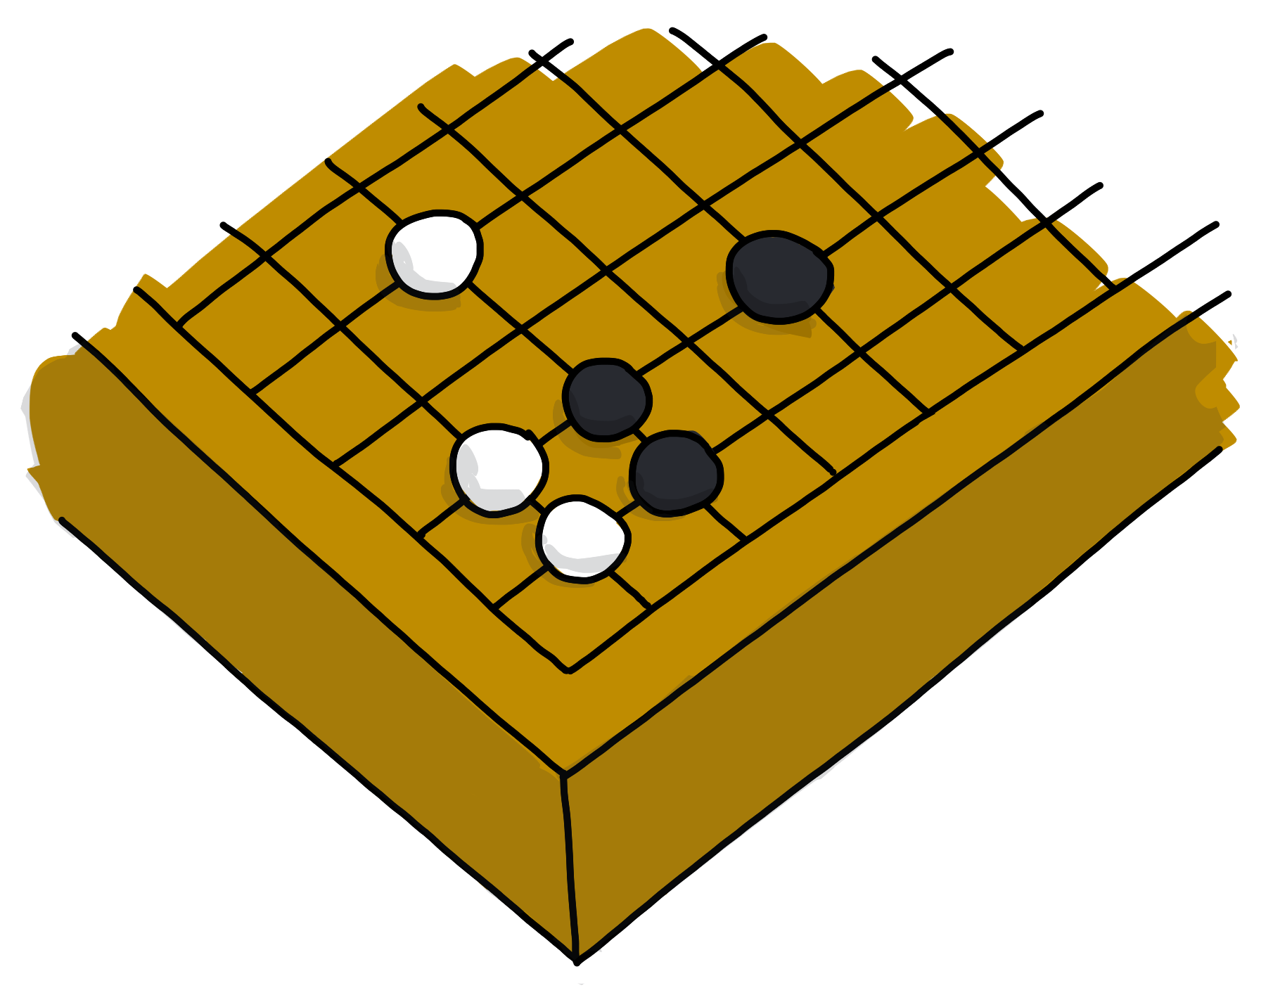
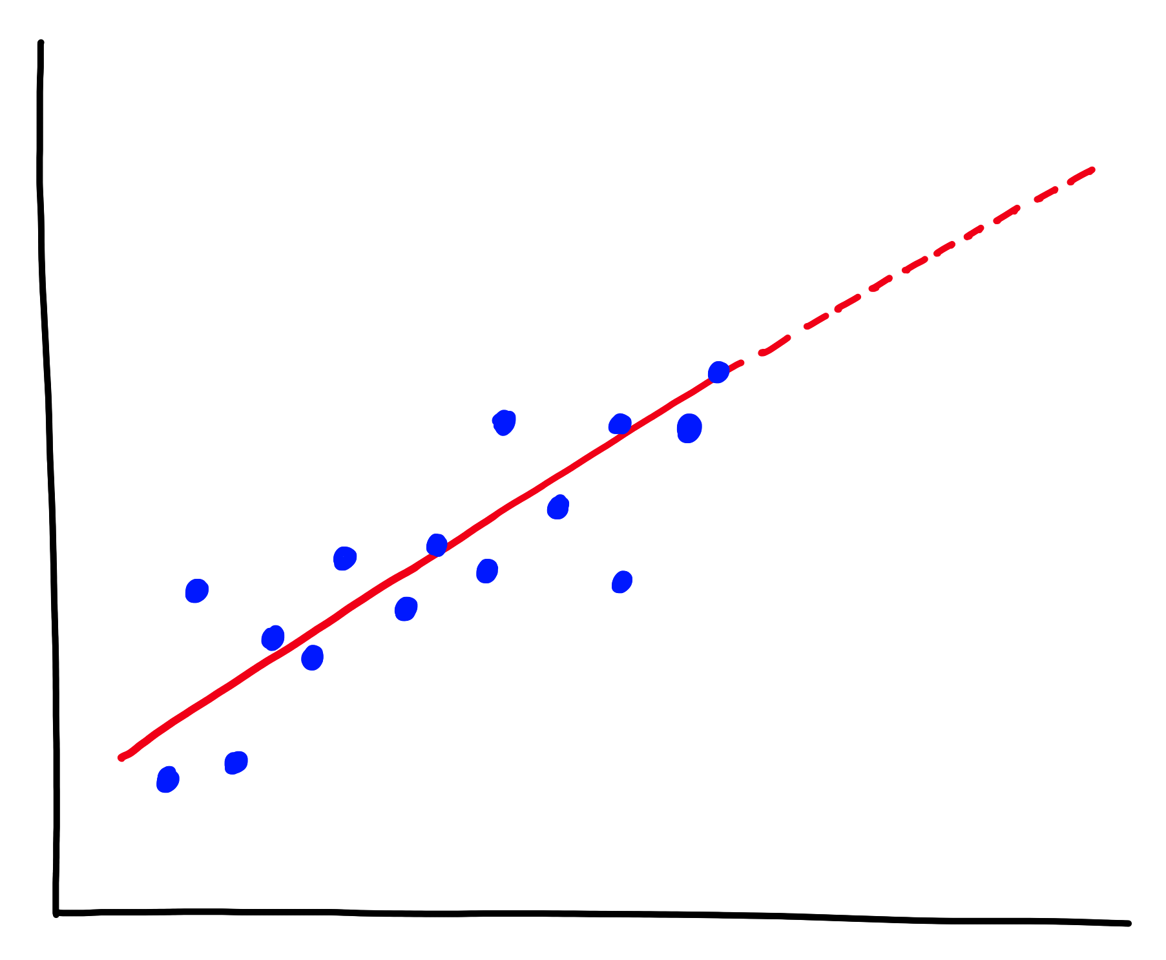
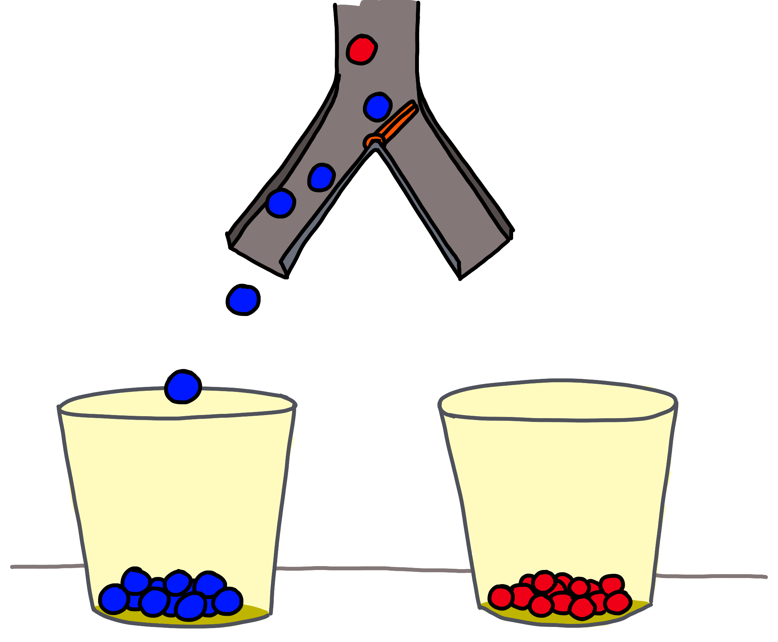
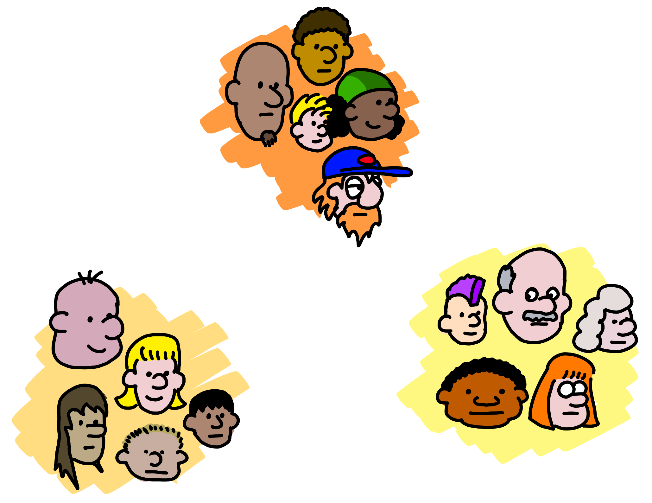
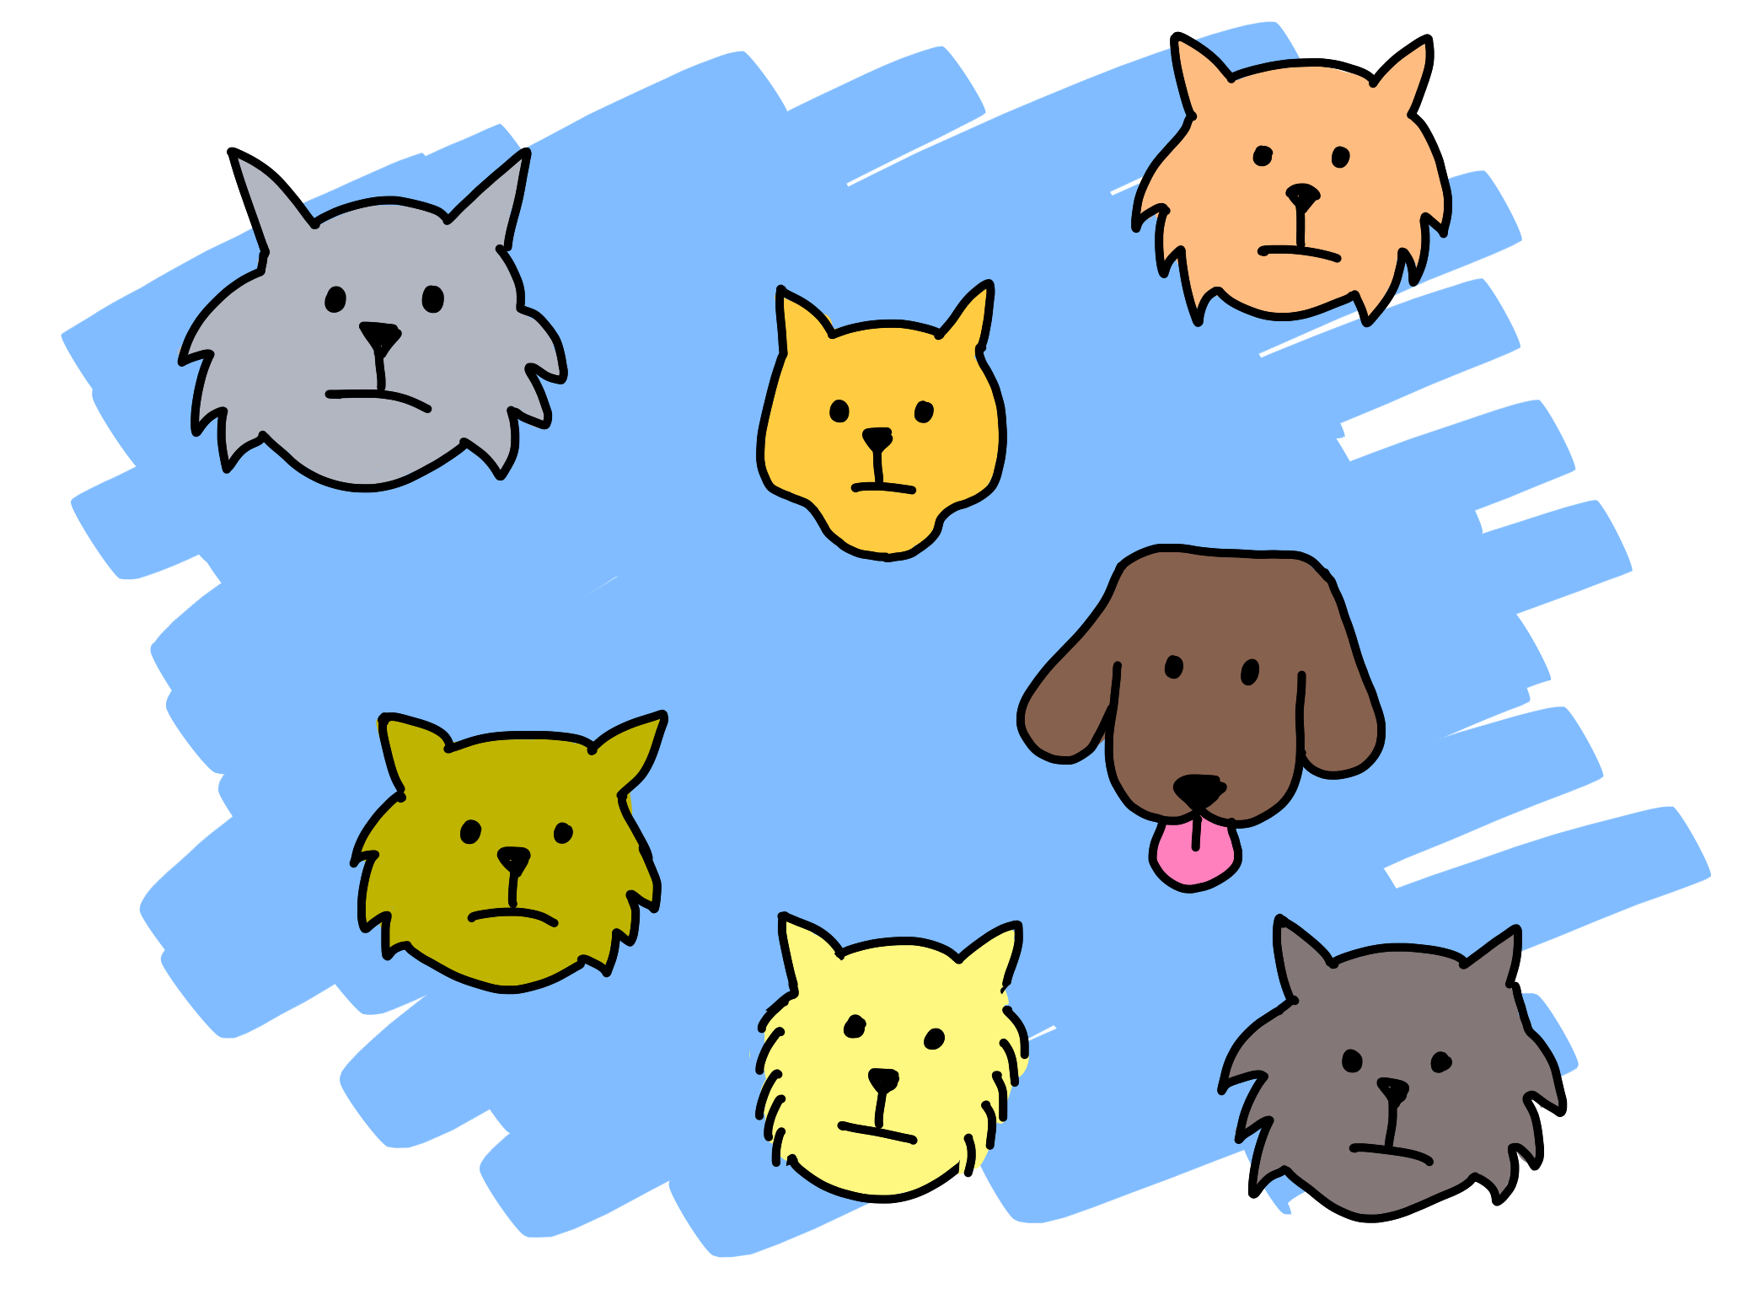
Quanto?
(Regressão)
Próximo Passo?
(Aprendizado por Reforço)
Qual Categoria?
(Classificação)
É estranho?
(Detecção de Anomalias)
Estrutura
(Agrupamentos, Recomendação)
5 perguntas (Brandon Rohrer)
Notes:
The five questions you can answer with traditional ML:
Regression: Predict a real value for new data given trends in this example. How much/how many? e.g. sea level rise: we are currently using data on sea level changes over the past century and the accelerating upward trend to estimate the amount of sea level rise in the coming century.
Anomaly: Identify when something unexpected happens. Is this weird? E.g. Pacemaker hacking: research is being done to detect malware in a pacemaker to prevent data hijacking or malware-related malfunctioning by using an anomaly detector to pick up changes in data transmission timing to a cardiac log or even power consumption and electromagnetic radiation changes.
Reinforcement Learning: Take some appropriate action or next step. E.g. Roomba or Roomba-competitor: a Roomba device decides whether to return to the base or vacuum the living room again. There’s some sort of reward/penalty involved here.
Classification: Assign a category to each item or data point. E.g. Exploring the night sky for planets: light curves (stellar brightness over time) of unexamined stars with Kepler data are being classified as either having transiting planets or not using a pre-trained model on stars with and without transiting planets.
Clustering/Recommenders: Get to the structure or layout of data. Are there obvious separable groups? E.g. Hepatocellular carcinoma metastasis: researchers are looking at the differential profiles of proteins being expressed to find those that are upregulated during the cell invasion process to find new cancer treatment targets.

Slide 14
Agora, vamos clonar o material do curso!
https://notebooks.azure.com/geektrainer/projects/ml-2
Caso não tenha uma conta da Microsoft, crie uma no Link Abaixo
account.microsoft.com

Slide 15
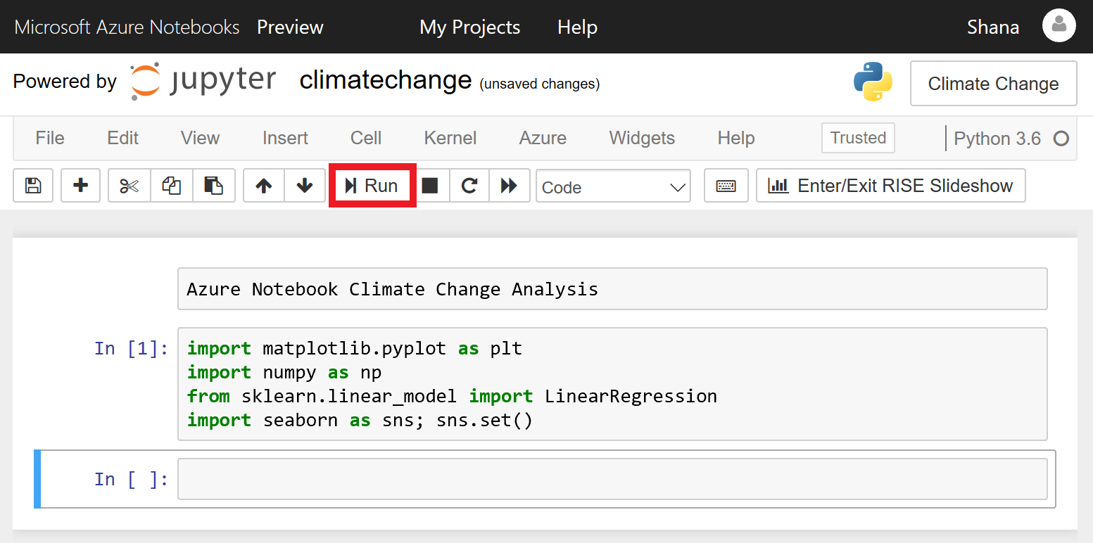
Como Navegar no Azure Notebooks
https://docs.microsoft.com/en-us/learn/modules/analyze-climate-data-with-azure-notebooks/1-create-an-azure-notebook
Notes:
Azure Notebooks is a cloud-based platform for building and running Jupyter Notebooks. Jupyter is an environment based on IPython that facilitates interactive programming and data analysis using a variety of programming languages, including Python. Jupyter Notebooks enjoy widespread use in research and academia for mathematical modeling, machine learning, statistical analysis, and for teaching and learning how to code.
Azure Notebooks provide Jupyter as a free service. It's a convenient way to build notebooks and share them with others without having to install and manage a Jupyter server. And it's web-based, making it an ideal solution for collaborating online. In this lab, you will create an Azure Notebook and use three popular Python libraries — scikit-learn, NumPy, and Seaborn — to analyze your data. Then you will share the notebook so others can experiment with it too.

Slide 16
Agrupamento K-Means
Notes:
Supervised machine learning (ML), in which we provide labeled training data for the algorithm. k-means clustering is the first unsupervised ML algorithm that we have dealt with: we provide the algorithm with a set of $n$ data points and tell the algorithm that we want that data partitioned into $k$ clusters that provide the best separation between clusters.

Slide 17
Quais alimentos têm a nutrientes similares?
Pergunta:

Slide 18
Tipo da Pergunta:
Agrupamento

Slide 19
Agrupamento K-Means
O Algoritmo:
Notes:
Supervised machine learning (ML), in which we provide labeled training data for the algorithm. k-means clustering is the first unsupervised ML algorithm that we have dealt with: we provide the algorithm with a set of $n$ data points and tell the algorithm that we want that data partitioned into $k$ clusters that provide the best separation between clusters.

Slide 20
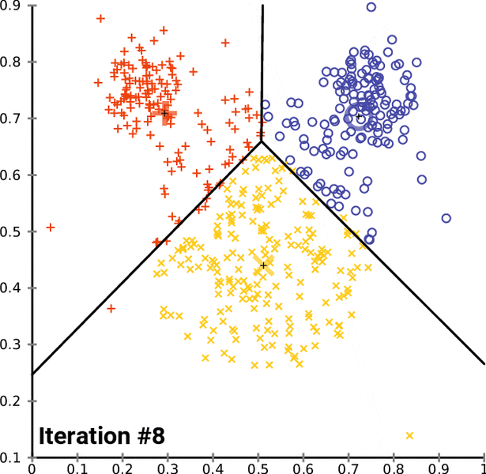
K-Means: A Teoria
Algoritmo de Aprendizado Não Supervisionado
Não precisa de rótulos (exemplos corretos, ou sim/não)
Quase sempre, o usuário define a quantidade de grupos
Existem variações
Iterativamente, o algoritmo tenta encontrar os grupos mais similares. Alguma ideia de como?
Notes:
The k-means algorithm is an example of unsupervised ML: all we do is give it the number of clusters to superimpose over a dataset and the algorithm goes to work knowing nothing about the data (such as examples of accurate classifications).
The k-means algorithm works by randomly assigning $k$ centroids (or geometric centers of subsets of the dataset as measured through Euclidean distance) to the data and then iteratively moving those centroids around the feature space until it converges on an arrangement of the centroids that minimizes the variance within the clusters.
Because k-means uses Euclidean distance, it is also a very fast algorithm for classifying new data points.

Slide 21
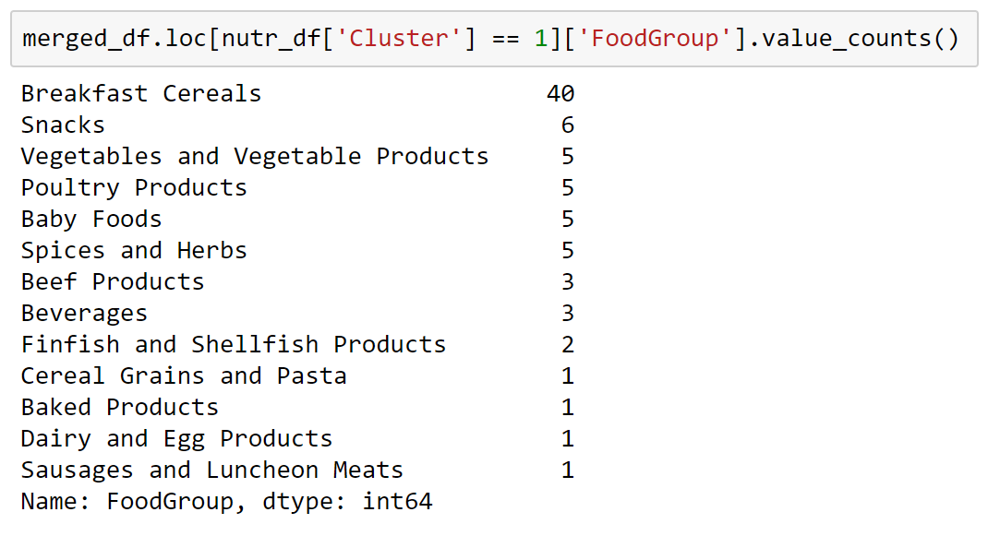
Interpretando o K-Means
Pontos similares estão próximos um dos outros.
Grupos representam um conjunto de pontos similares.
Notes:
What sorts of foods populate the different clusters? We will examine that question in greater depth in the section, but we can get some sense of our clusters just by looking at the food groups in one of them.
Some of the entries in this cluster make sense, whereas others look kind of like the contents of a grab bag. Part of the reason for this is that the k-means algorithm must draw rather arbitrary boundaries between clusters; there will be a lot of entries in all clusters that are right on the edge and could reasonably belong to two or more clusters.

Slide 22
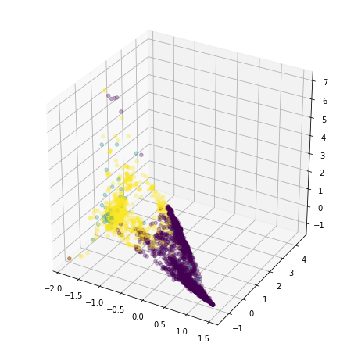
Visualizando o K-Means
O limiar entre os grupos nem sempre será claro com poucas dimensões.
Ao executar um PCA nos dados previamente
Alguns grupos parecem mais colapsados por conta da escala dos valores e direção da projeção.
Notes:
Like the situation with PCA, we can create visualizations of our clusters, but visualization is crude at best when it has been projected downward through so many dimensions. That said, even when trying to project from 43 dimensions down to 3 dimensions, noticeable patterns persist.
Notice that there’s no hard boundary visible between the purple and yellow clusters. The boundary is there, but because it's a higher-dimensional hyperplane, it gets smeared across three-dimensional space.
Note also that points from the light blue cluster are scattered across the plot. This is also an artifact of the clusters’ projection down from 43 dimensions to 3.

Slide 23
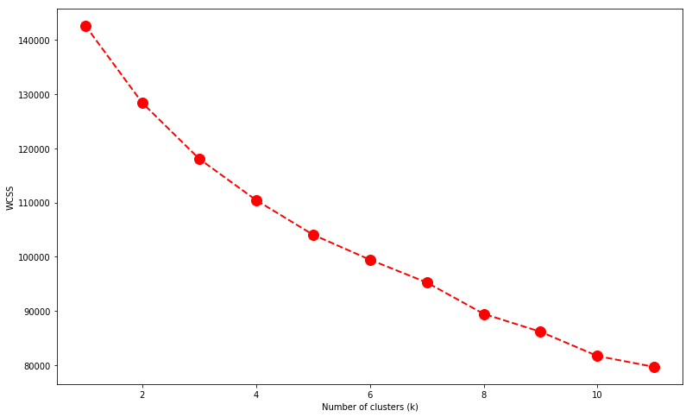
Definindo o Número de Grupos
Método do cotovelo, similar ao Scree Plot do PCA
Escolha o número K onde a variação parece se reduzir.
Notes:
In practice, determining the correct number of clusters can require a lot of domain knowledge and data interpretation. However, we can use the elbow method as a rough heuristic for determining the number of clusters to use, even absent any domain knowledge.
With the elbow method, we plot the within-cluster sum of squares (WCSS, a measure of the variability of the observations within each cluster) against different values of $k$. As with the scree graph we used with PCA, we’re looking for the value of $k$ near where WCSS begins to flatten out and form an elbow-shaped curve.

Slide 24
Naïve Bayes
Notes:
In contrast to k-means clustering, Naive Bayes is a supervised machine-learning (ML) algorithm. It provides good speed and good accuracy, and it is often used in aspects of natural-language processing such as text classification or, in our case in this section, spam detection.
Spam emails are more than just a nuisance. As recently as 2008, spam constituted an apocalyptic 97.8 percent of all email traffic, according to a 2009 Microsoft security report. That tide has thankfully turned, and, as of May 2019, spam makes up only about 85 percent of email traffic—thanks in no small part to naive Bayes spam filters.
Naive Bayes is a convenient algorithm for spam detection because it does not require encoding complex rules. All it needs is training examples, of which there are plenty when it comes to email spam. Naive Bayes does all this through the use of conditional probability.

Slide 25
Esta mensagem é spam?
A Pergunta:

Slide 26
O Tipo:
Classificação

Slide 27
Naïve Bayes
O Algoritmo

Slide 28
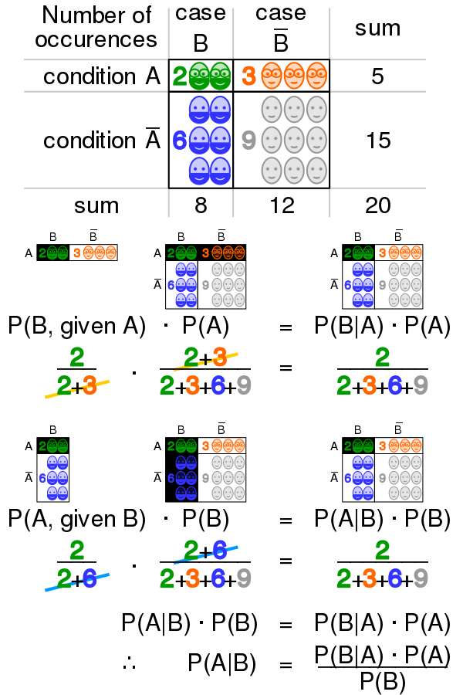
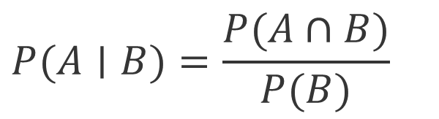
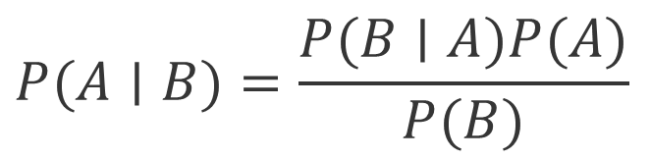
Probabilidade Condicional (Bayes)
Probabilidade de um evento condicionado em outro. Observe: P(A e B) = P(A|B) P(B)
Podemos reescrever nas duas direções. Observe o numerador: P(A e B) = P(B|A) P(A)
$$P(A∣B)=\frac{P(A∩B)}{P(B)}$$
$$P(A∣B)=\frac{P(B∣A)P(A)}{P(B)}$$
Notes:
Ordinary probability deals with the likelihood of isolated events occurring. Conditional probability concerns itself with the contingencies of interconnected events: what is the probability of event $A$ happening if event $B$ occurs. Mathematicians denote this as $P(A∣B)$, or “the probability of $A$ given $B“$.
However, to compute conditional probabilities, we need know the joint probability $P(A∩B)$, which we often don't. Instead, we often need to know something about $A$, but all we can directly observe is $B$. An example of this is when we want to infer whether an email is spam only by knowing the words it contains. For this, we need Bayes' law.
Bayes’ law takes its name from the eighteenth-century English statistician and philosopher Thomas Bayes, who described the probability of an event based solely on prior knowledge of conditions that might be related to that event. In words, Bayes’ law says that if I know the prior probabilities $P(A)$ and $P(B)$, in addition to the likelihood (even just an assumed likelihood) $P(B∣A)$, I can compute the posterior probability $P(A∣B)$. Let's apply this to spam.

Slide 29
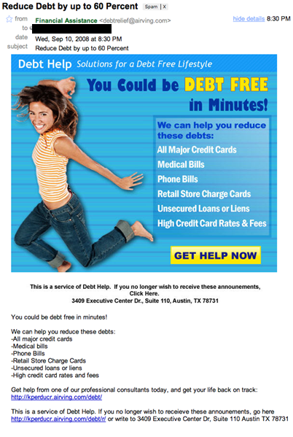
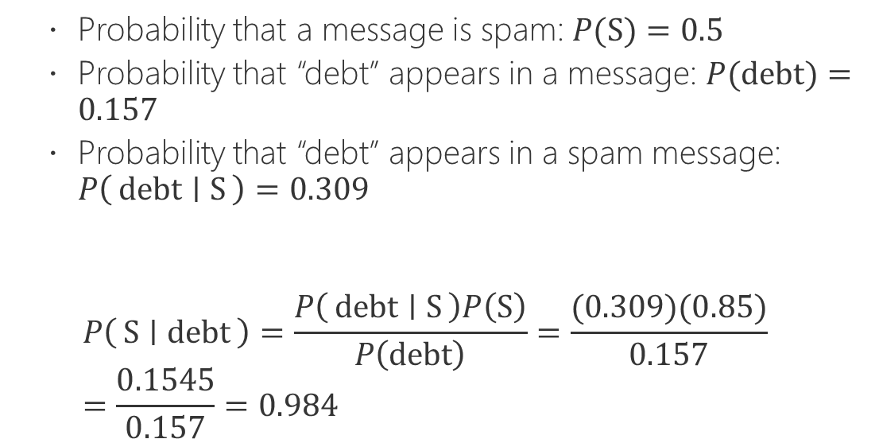
Aplicando a Regra de Bayes
Probabilidade que a mensagem é spam: P(S) = 0.5
Probabilidade da palavra debt na mensagem: P(debt) = 0.157 (proporcional a frequência)
Probabilidade que a palavra debt ocorra em ALGUMA mensagem spam: P(debt | S) = 0.309
Probability that a message is spam: $P(S)=0.5$
Probability that “debt” appears in a message: $P(debt)=0.157$
Probability that “debt” appears in a spam message: $P\left(debt ∣ S\right)=0.309$
$$P\left(S ∣ debt\right)=\frac{P\left(debt ∣ S\right)P\left(S\right)}{P\left(debt\right)}=\frac{(0.309)(0.85)}{0.157}=\frac{0.1545}{0.157}=0.984$$
Notes:
To use Bayesian probability on spam email messages like this one, consider it (and all other emails, whether spam or ham) to be bags of words. We don’t care about word order or even word meaning. We just want to count the frequency of certain words in spam messages versus the frequency of those same words in valid email messages.
Let’s say that, after having counted the words in hundreds of emails that we have received, we determine the probability of the word “debt” appearing in any kind of email message (spam or ham) to be 0.157, with the probability of “debt” appearing in spam messages being 0.309. Furthermore, let’s say we assume that there’s a 50 percent chance that any given email message we receive is spam (for this example, we don't know either way what type of email it might be, so it’s basically a coin flip).
By the calculations on the slide, if an email contains the word “debt,” we predict that it is 98.4 percent likely to be spam.

Slide 30
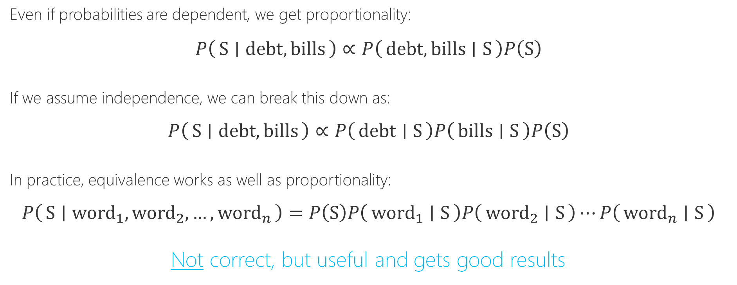
A Premissa Ingênua (Naive)
Even if probabilities are dependent, we get proportionality:
$$P\left(S ∣ debt, bills\right)∝P\left(debt, bills ∣ S\right)P\left(S\right)$$
If we assume independence, we can break this down as:
$$P\left(S ∣ debt, bills\right)∝P\left(debt ∣ S\right)P\left(bills ∣ S\right)P\left(S\right)$$
In practice, equivalence works as well as proportionality:
$$P\left(S ∣ {word}_{1}, {word}_{2},…,{word}_{n}\right)=P\left(S\right)P\left({word}_{1} ∣ S\right)P\left({word}_{2} ∣ S\right)⋯P\left({word}_{n} ∣ S\right)$$
Not correct, but useful and gets good results
A premissa é fazer uso de proporções
Além do mais, vamos assumir independência entre as palavras.
Sabendo que quando eventos são independentes (estamos assumindo): P(A e B) = P(A) P(B)
Notes:
Our above calculation is great for looking at individual words, but emails contain several words that can give us clues to an email’s relative likelihood of being spam or ham. For example, say we wanted to determine whether an email is spam given that it contains the words “debt” and “bills”. We can begin by reasoning that the probability that an email containing “debt” and “bills” is spam is, if not equal, at least proportional to the probability of “debt” and “bills” appearing in known spam messages times the probability of any given message being spam: $P\left(S ∣ debt, bills\right)∝P\left(debt, bills ∣ S\right)P\left(S\right)$
Now, if we assume that the occurrence of the words “debt” and “bills” are independent events, we can extend this proportionality: $P\left(S ∣ debt, bills\right)∝P\left(debt ∣ S\right)P\left(bills ∣ S\right)P\left(S\right)$
We should state here that this assumption of independence is generally not true. Just look at the example spam message above. The probability that “bills” will appear in a spam message containing “debt” is probably quite high. However, assuming the probabilities of words occurring in our email messages are independent is useful and works surprising well. This assumption of independence is the naive part of the Bayesian probabilities that we will use in this section. Expressed mathematically, the working assumption that will underpin the ML in this section is that for any collection of $n$ words: $P\left(S ∣ {word}_{1}, {word}_{2},…,{word}_{n}\right)=P\left(S\right)P\left({word}_{1} ∣ S\right)P\left({word}_{2} ∣ S\right)⋯P\left({word}_{n} ∣ S\right)$
We cannot emphasize enough that this chain rule expressed in the equation above—that the probability of a message being spam based on the words in it is equal to the product of the likelihoods of those individual words appearing in messages known to be spam—is not true. But it gets good results and, in the world of data science, fast and good enough always trump mathematical fidelity.

Slide 31
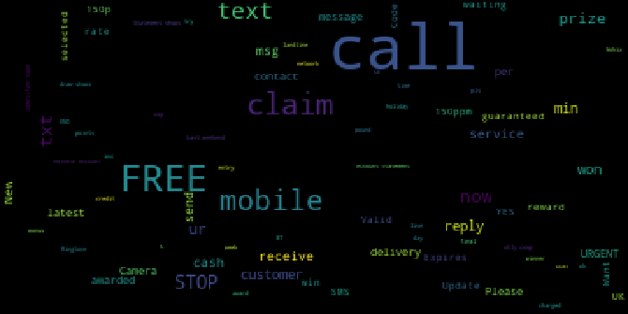
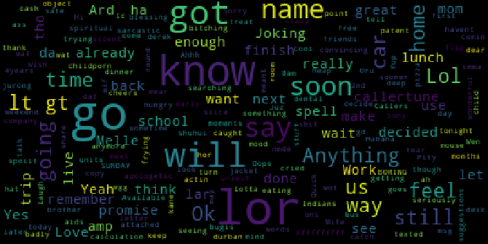
Exploração: Nuvens de Palavras
Spam
Ham
Dados: 5,574 mensagens SMS manualmente anotadas como “spam” or “ham”.
Notes:
In this section, we will use the SMS spam collection dataset. It contains 5,574 messages collected for SMS spam research and tagged as “spam” or “ham”. The dataset files contain one message per line, with each line being composed of the tag and the raw text of the SMS message.
Because our data is largely not numeric, you might have noticed that some of our go-to data exploration tools (such as bar charts and the describe() method) have been of limited use in exploring this data. Instead, word clouds can be a powerful way of getting a quick glance at what's represented in text data as a whole.
Looking at the two-word clouds, it’s immediately apparent that the frequency of the most common words is different between our spam and our ham messages, which will form the primary basis of our spam detection.

Slide 32
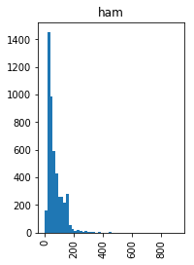
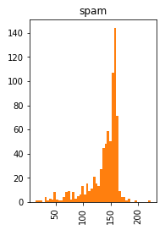
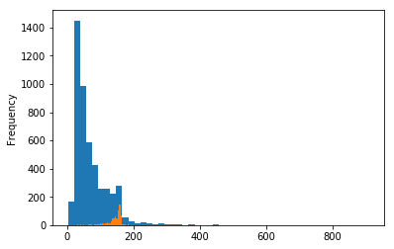
Exploração: Tamanho da Mensagem
Na média, mensagens de spam são bem maiores do que mensagens de ham.
Notes:
Just because the data does not naturally lend itself to numerical analysis “out-of-the-box” does not mean that we can't do so. We can also analyze the average length of spam and ham messages to see whether there are differences. And, sure enough, spam messages are much longer on average than ham messages.

Slide 33
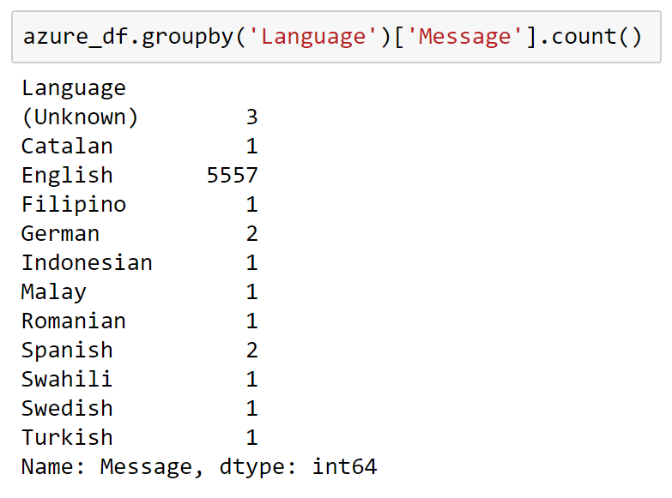
Exploração: Línguas
Fazendo uso do Azure Cognitive Services é possível identificar a língua de cada mensagem
Existem poucas mensagens que não são em inglês. Esperamos então que manter ou remover as mesmas tenha pouco impacto no nosso exemplo.
Notes:
The advantage of using cloud-based services is that they provide cutting-edge models that you can access without having to train the models. This can help accelerate both your exploration and your use of ML.
Azure provides Cognitive Services APIs that can be consumed using Python to conduct image recognition, speech recognition, and text recognition—just to name a few. For the purposes of this subsection, we're going to look at using the Azure Text Analytics API.
The overwhelming majority of the messages are in English, though we have several additional languages in our dataset. Let's look at the actual numbers.

Slide 34
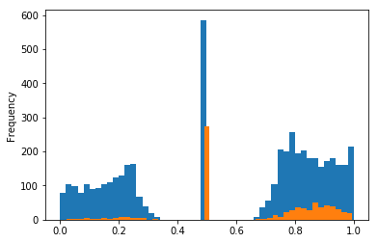
Exploração: Sentimentos
O Azure Cognitive Services também é capaz de identificar sentimentos.
Muitas mensagens spam são neutras (sentimento de 0.5)
Existem mais mensagens Spam com sentimento positivo (acima de 0.5)
Notes:
It’s perhaps not too surprising that the sentiments represented in the dataset should be bifurcated: SMS is a medium that captures extremes better than nuanced middle ground. That said, the number of dead-center messages is interesting. The proportion of spam messages right in the middle is also interesting.

Slide 35
Regressão Linear
Notes:
In contrast to k-means clustering, Naive Bayes is a supervised machine-learning (ML) algorithm. It provides good speed and good accuracy, and it is often used in aspects of natural-language processing such as text classification or, in our case in this section, spam detection.
Spam emails are more than just a nuisance. As recently as 2008, spam constituted an apocalyptic 97.8 percent of all email traffic, according to a 2009 Microsoft security report. That tide has thankfully turned, and, as of May 2019, spam makes up only about 85 percent of email traffic—thanks in no small part to naive Bayes spam filters.
Naive Bayes is a convenient algorithm for spam detection because it does not require encoding complex rules. All it needs is training examples, of which there are plenty when it comes to email spam. Naive Bayes does all this through the use of conditional probability.

Slide 36
O PIB per-capita tem algum impacto na expectativa de vida de mulheres?
A Pergunta:

Slide 37
O Tipo:
Regressão

Slide 38
Regressão Linear e Polinomial
O Algoritmo:

Slide 39
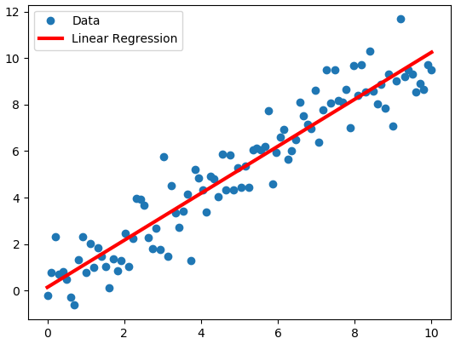
Overview of Regression
"Desenhe a linha"
Ou melhor, encontre a tendência de y como função de x. Na equação abaixo, o símbolo de . representa o produto. y = β₀ + β₁.x
Dados: United Nations national statistics from 2009-2011
Notes:
The essence of linear regression is arguably the simplest form of ML: drawing a line through points. You might have done a simple form of this in your high school physics class: plot the results of a series of experiments on graph paper, and then draw a line through as many points as possible (and include as many points below the line as above the line where the points don't fall on the line). That is a basic form of linear regression. We will build on that conceptual foundation to address more complex situations, such as having points in more than two dimensions or even points whose relationship seems non-linear.
Formally, linear regression is used to predict a quantitative response (the values on a Y axis) that is dependent on one or more predictors (values on one or more axes that are orthogonal to $Y$, commonly just thought of collectively as $X$). The working assumption is that the relationship between the predictors and the response is more or less linear. The goal of linear regression is to fit a straight line in the best possible way to minimize the deviation between our observed responses in the dataset and the responses predicted by our line, the linear approximation.
How do we tell whether we have the best fit possible for our line? The most common means of assessing the error between the fit of our line—our model—and the data is called the least squares method. This method consists of minimizing the number you get when you square the differences between your predicted values (the line) and the actual values (the data) and add up those squared differences for your entire dataset.
In this section and the next, we will use national statistics gathered by the United Nations (UN) from 2009–2011 (accessed from the United Nations Statistics Division's Social indicators page on April 23, 2012). The data includes national health and welfare statistics for 199 countries and territories. These locations are mostly UN members, but the list also includes other areas that are not independent countries (such as Hong Kong).

Slide 40
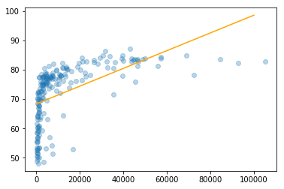
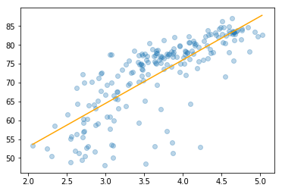
Regressão Linear Simples
Transformações nos dados pode ajudar. Nem sempre o ajuste de y será um função linear de x
Exemplo: PIB (eixo-x) por expectativa de vida (eixo-y). Uma transformação log parece ajudar.
Notes:
This first model accounts for only 30 percent of the variability in female life expectancy and is not a very good representation of the relationship between economic activity and female life expectancy.
These results are not good, which stems from the fact that there’s no linear relationship between per-capita GDP and female life expectancy. Instead, the relationship has an elbow-like curve to it. When countries are very poor, the data suggests that even modest increases to GDP per capita can dramatically increase female life expectancy, but only up to a point. After countries hit about USD $10,000 per head, additional gains correlated to increases in wealth are much smaller. This suggests a logarithmic relationship between these factors: female life expectancy is not related to GDP, but rather to its logarithm.

Slide 41
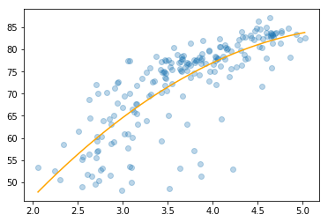
Polynomial Regression
A linearidade da regressão linear é nos parâmetros (ou coeficientes). Em outras palavras nos betas y = β₀ + β₁.x
Abaixo temos uma regressões linear com transformada polinomial (regressão polinomial) y = β₀ + β₁.x + β₂.x²
Notes:
The linearity of our models depends on the linearity of $β_{n}$, not $x_{n}$. We will use this fact to use linear regression to model data that does not follow a straight line. Adding the polynomial term provides us with a much more intuitive fit of the data.

Slide 42
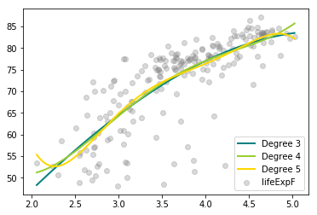
Overfitting de Modelos
Podemos fazer uso de polinômios de grau cada vez maior.
Quanto maior, mais super ajustado fica o modelo para os dados (overfitting)
Notes:
Each additional polynomial degree improves the fit of our model. However, adding more degrees to the polynomial regressions opens us to the risk of overfitting, a process by which our models come to fit the training data too closely, and are thus less useful in predicting more generalized data.
Higher-degree polynomials also bring back the curse of dimensionality. Simple linear models need only $N+1$ sample points to fit, where $N$ is the number of dimensions (2 points in one dimension, 3 in two dimensions, 4 in three dimensions, and so on). However, each additional polynomial degree increases the number of sample points required for a given dimensionality much faster. Particularly if certain data points are difficult or expensive to come by, you might run out of data to fit a high-degree polynomial model.

Slide 43
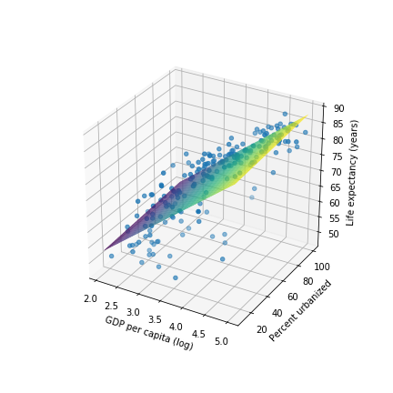
Regressão Múltipla
Podemos criar modelos com múltiplos atributos.
Exemplo ao lado onde expectativa de vida é uma função de PIB e Urbanização.
Notes:
Ultimately, no matter how complex the model we construct between two features, we will only be able to explain so much of variability because factors other than GDP affect the response. Using more than one predictor in our regression model helps us capture more of this richness of detail.

Slide 44
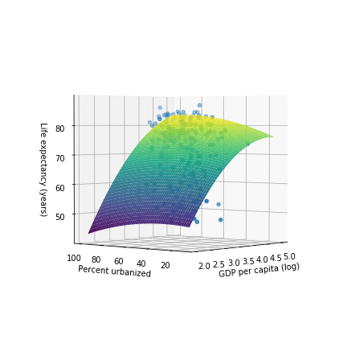
Regressão Múltipla Polinomial
Podemos aplicar transformadas, polinomial ou não, em qualquer atributo
Ainda é uma regressão linear nos coeficientes
Notes:
Each additional polynomial degree improves the fit of our model. However, adding more degrees to the polynomial regressions opens us to the risk of overfitting, a process by which our models come to fit the training data too closely, and are thus less useful in predicting more generalized data.
Higher-degree polynomials also bring back the curse of dimensionality. Simple linear models need only $N+1$ sample points to fit, where $N$ is the number of dimensions (2 points in one dimension, 3 in two dimensions, 4 in three dimensions, and so on). However, each additional polynomial degree increases the number of sample points required for a given dimensionality much faster. Particularly if certain data points are difficult or expensive to come by, you might run out of data in order to fit a high-degree polynomial model.

Slide 45
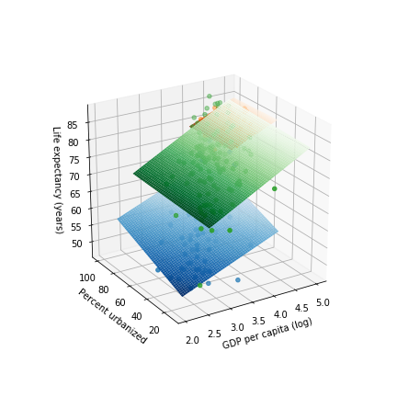
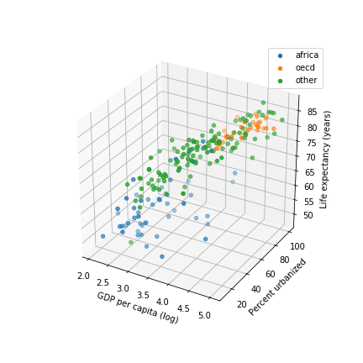
Dados Categóricos
Nem sempre os dados são numéricos. Em alguns casos os dados são categóricos
Realizamos one hot encoding. Cada categoria vira uma coluna com 1 ou 0
Notes:
Our dataset has two categorical features (also known as factors in the statistical world): region and group. There are multiple ways of handling data like this in linear regression; here, we will handle it by building sub-models for it.
Unsurprisingly, OECD-member countries cluster at the high end of the income scale and, sadly, African countries lag at the poorer end. Countries from the other group include countries ranging from poor ones in Southeast Asia to oil-rich Middle Eastern countries, and thus countries from that group are scattered across the income spectrum.
Now that we have the data points detailed in color, let's fit three separate, simple linear models for each group of countries. What do these plots based on group tell us? The slopes for log_ppgdp are similar between the africa and oecd groups, but the slope is different for the other group. This suggests that there might be some interaction between group and log_ppgdp in explaining lifeExpF. The pctUrban slope for the oecd group has a different sign than for africa or other, which might indicate another interaction, but we’re on shaky statistical ground here because we have done no testing to see whether these differences in slope are statistically significant (for pctUrban, the differences—and the numbers—are small).
What do we mean by interactions between groups? Recall that we generalized a linear model with two features as:
$$y=β_{0}+β_{1}x_{1}+β_{2}x_{2}$$
However, if $x_{1}$ and $x_{2}$ interact—if different values of $x_{1}$, for example, change the influence of $x_{2}$ on $y$—we need to include that in the model like so:
$$y=β_{0}+β_{1}x_{1}+β_{2}x_{2}+β_{3}{x_{1}x}_{2}$$
Our model involves three predictors (log_ppgdp, pctUrban, and group) and has this form:
$$y=β_{0}+β_{1}x_{1}+β_{2}x_{2}+β_{3}u_{2}+β_{4}u_{3}+β_{5}{x_{1}x}_{2}+β_{6}x_{1}u_{2}+β_{7}x_{1}u_{3}+β_{8}x_{2}u_{2}+β_{9}x_{2}u_{3}+β_{10}x_{1}{x_{2}u}_{2}+β_{11}x_{1}{x_{2}u}_{3}$$
Think of this as another aspect of the curse of dimensionality: as we add features (especially categorical ones), the number of potential interactions between features that we account for increases even faster.

Slide 46
Compartilhe sua Opinião!
https://aka.ms/ReactorFeedback

Slide 47
Regressão Linear (parte 2)

Slide 48
Regressão Linear (2)
Azure Machine Learning Studio
Validação Cruzada
One-hot encoding
Regressão Ridge

Slide 49
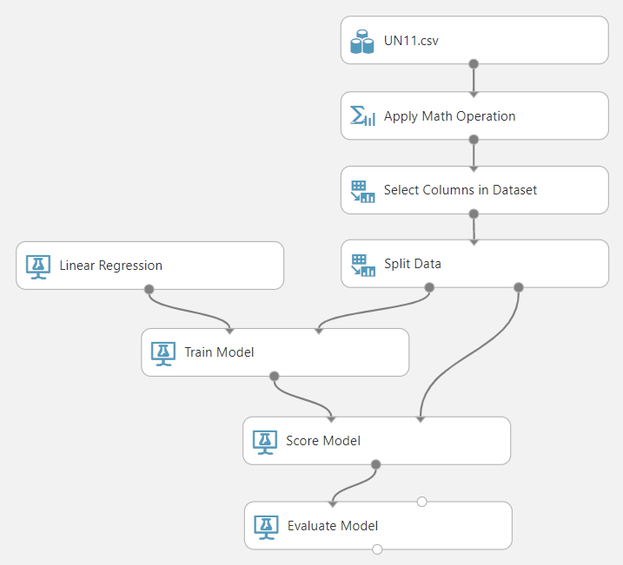
Azure Machine Learning Studio
Interface de arrastar e soltar (GUI)
Automatiza a implantação de modelos de aprendizado de máquina como serviços para aplicações terceiras
Notes:
So far in this track, we have examined building and fitting ML models “locally”. True, the notebooks have been located in the cloud themselves, but the models with their predictive and classification power are stuck in those notebooks. To use these models, you would have to load data into your notebooks and get the results there.
In practice, we want those models to be accessible from several locations. And although the management of production ML models has a lifecycle all its own, one part of that is making models accessible from the web. One way to do that is to develop them by using third-party cloud tools, such as Microsoft Azure ML Studio (not to be confused with Microsoft Azure Machine Learning Service, which provides end-to-end life-cycle management for ML models).
Alternatively, we can develop and deploy a function that can be accessed by other programs over the web—a web service—that runs within Azure ML Studio. Cloud-based ML-development tools like Azure ML Studio streamline the building, training, and deployment of machine learning models by providing a drag-and-drop interface and making a wide array of ML algorithms and tools readily available. Crucially, such tools simplify the deployment and management of ML models in production (not a focus of this course, but a major consideration in the real world).

Slide 50
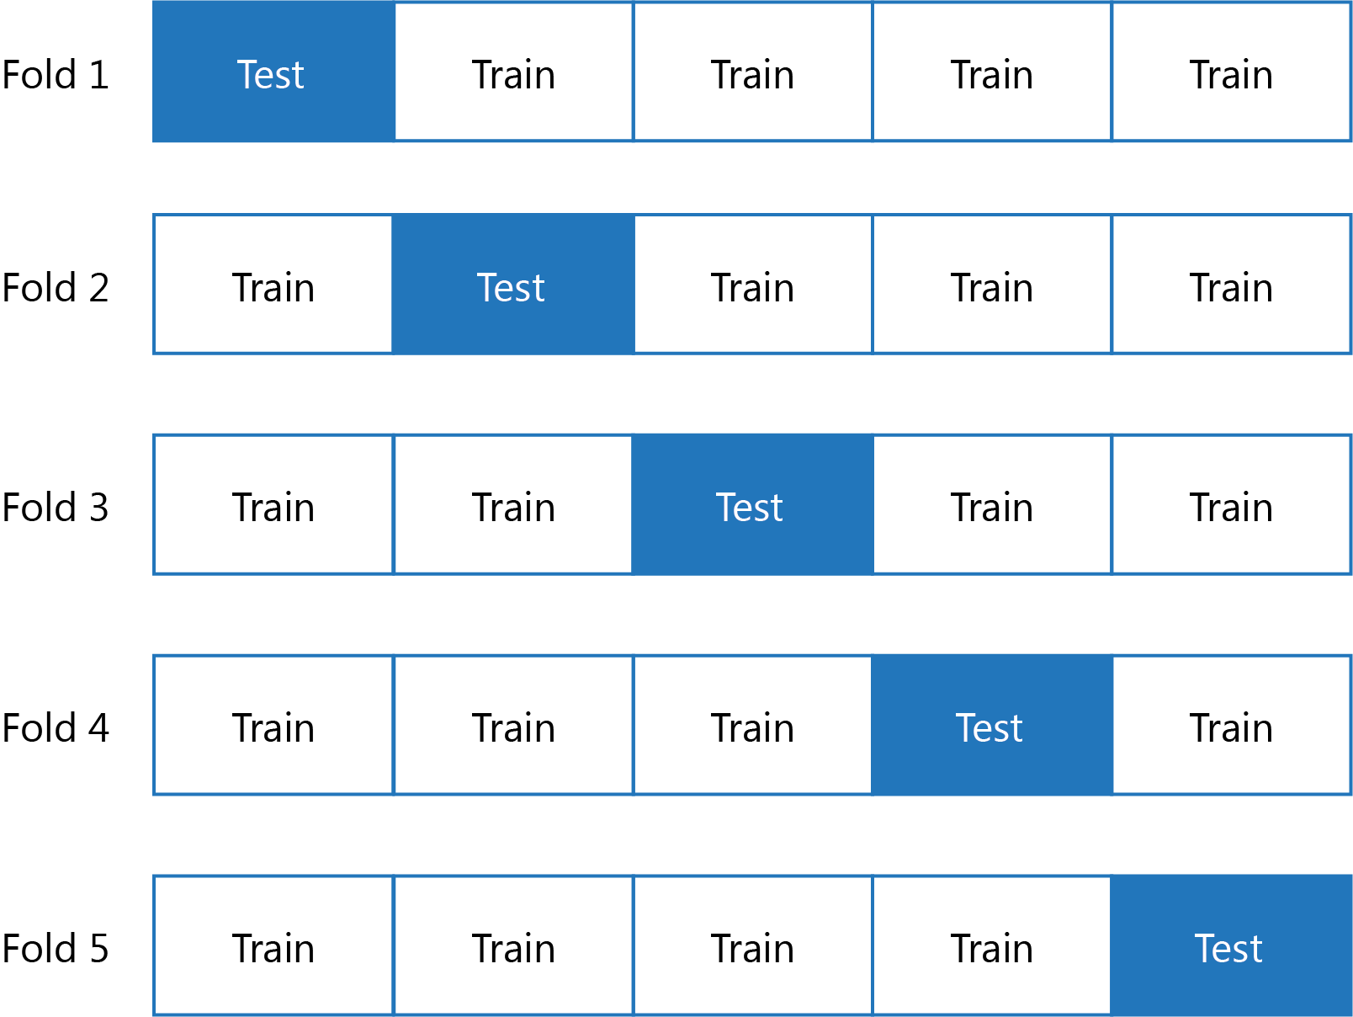
Validação Cruzada
Divide o conjunto de dados em múltiplos
Observe como alguns são treino outros são teste
O principal problema de aprendizado de máquina é na generalização
Conjuntos de testes servem para mensurar tal generaização
Notes:
The idea behind cross validation is that a single set of data is split multiple times between test and training data and is then evaluated. Each iteration of the splitting of this data is referred to as a “fold”. Using 10 folds to evaluate a model is ten-fold cross validation; more generally, data scientists speak of $k$-fold cross validation. The resulting score for a given model is the average of its performance against the different folds.
Cross validation can give you a more consistent picture of your model's performance again new data. This is important in production, but one tradeoff that comes with it is computational time: your model completes an entire run for each fold of your cross validation. For computationally-intense models, including many folds in cross validation might not be feasible.

Slide 51
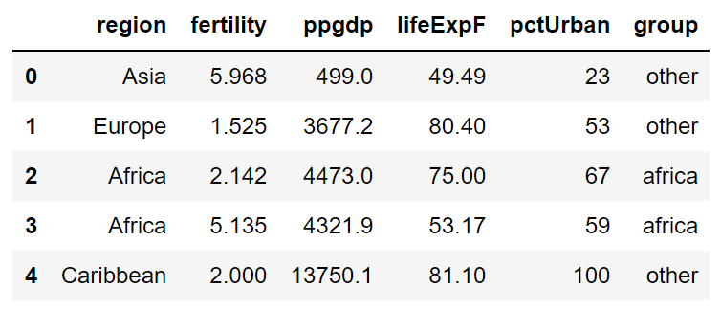
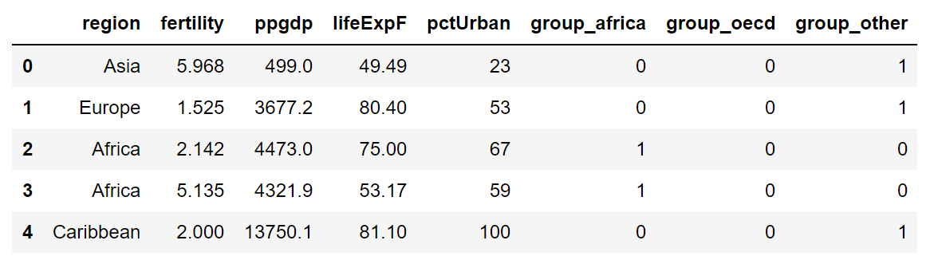
One-Hot Encoding
Transforma cada categoria em uma coluna numérica.
Notes:
Azure ML Studio uses a technique call one-hot encoding in which categorical features are assigned a state of 1 or 0 based on whether they are true. Thus, an OECD member country would have a value of 1 for the oecd value in group and 0s for africa and other. Another term for this is dummy variables.

Slide 52
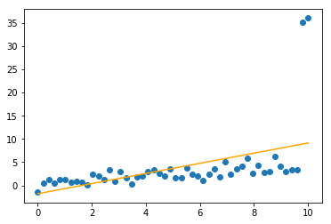
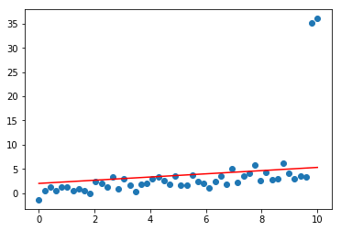
Ridge Regression
Valores extremos afetam a regressão
Regressão Ridge (ou regularização L2) ajuda
Without regularization
With L2 regularization
Notes:
Outliers in our training data—that is, data points that stray from the general clustering of other data points—are problematic because they skew our model while we are fitting it. The outliers have dragged the regression line on the left of the slide off the cluster.
One way to address this is to add an additional weighted term to the ordinary least squares equation that we used to calculate our regression line. Tuning this weight parameter for this additional term will help our regression put less emphasis on the outlying points and greater emphasis on the well-clustered points. The specific technique we will use for this is called ridge regression (also referred to as L2 regularization).

Slide 53
Mais Recursos em Ciência de Dados e Aprendizado de Máquina
Existe todo um ambiente de aprendizado na nuvem no Microsoft Learn!
Resumo deste curso
docs.microsoft.com/learn/paths/intro-to-ml-with-python/
Um poucos mais dos princípios e metodologias de ciência de dados
docs.microsoft.com/learn/paths/explore-data-science-tools-in-azure/
Próximos passos na construção de soluções de inteligência artificial
docs.microsoft.com/learn/paths/build-ai-solutions-with-azure-ml-service/
Máquinas virtuais para ciência de dados
docs.microsoft.com/learn/paths/get-started-with-azure-dsvm/
Aprenda mais sobre o Azure
docs.microsoft.com/learn/paths/azure-fundamentals/

Slide 54

Certificados Microsoft
Ciência de Dados:
Azure Data Engineer Associate
Azure Data Scientist Associate
Azure Developer Associate
Outros Assuntos:
Azure Fundamentals
Azure AI Engineer Associate

Slide 55
developer.microsoft.com/reactor/
@MSFTReactor no Twitter
Notes:
Thank you!

